Slide 1
Convex Hull

Slide 2
Convex hull
The convex hull of a set Q of points is the smallest convex polygon P for which each point in Q is either on the boundary of P or in its interior.
We denote the convex hull of Q by CH(Q).
Intuitively, we can think of each point in Q as being a nail sticking out from a board.
The convex hull is then the shape formed by a tight rubber band that surrounds all the nails.

Slide 3
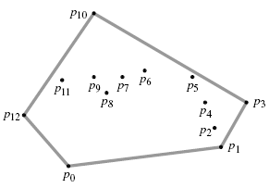
Convex hull: Example

Slide 4
Graham’s scan Algorithm
Graham’s scan solves the convex-hull problem by maintaining a stack S of candidate points.
Each point of the input set Q is pushed once onto the stack, and the points that are not vertices of CH(Q) are eventually popped from the stack.
When the algorithm terminates, stack S contains exactly the vertices of CH(Q), in counterclockwise order of their appearance on the boundary.

Slide 5
Graham’s scan Algorithm
The procedure GRAHAM-SCAN takes as input a set Q of points, where |Q| ≥ 3.
It calls the functions TOP(S), which returns the point on top of stack S without changing S, and NEXT-TO-TOP(S), which returns the point one entry below the top of stack S without changing S.
The stack S returned by GRAHAM-SCAN contains, from bottom to top, exactly the vertices of CH(Q) in counterclockwise order.

Slide 6
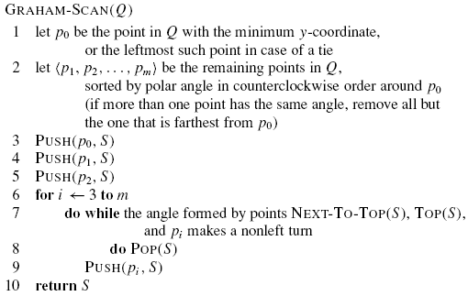
Graham’s scan Algorithm
Complexity: ?

Slide 7
Graham’s scan Algorithm
Complexity: O(mlogm)

Slide 8
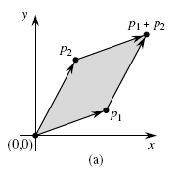
Finding left turn
Cross products
Consider vectors p1 and p2. The cross product p1 × p2 can be interpreted as the signed area of the parallelogram formed by the points (0, 0), p1, p2, and p1 + p2 = (x1 + x2, y1 + y2).

Slide 9

Finding left turn
An equivalent, but more useful, definition gives the cross product as the determinant of a matrix:
If p1× p2 is positive, then p2 is counterclockwise (left turn) from p1 with respect to the origin (0, 0);
If this cross product is negative, then p2 is clockwise (right turn) from p1.

Slide 10
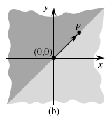
Finding left turn
Following figure shows the clockwise and counterclockwise regions relative to a vector p.
The lightly shaded region contains vectors that are clockwise from p. The darkly shaded region contains vectors that are counterclockwise from p.
A boundary condition arises if the cross product is 0; in this case, the vectors are collinear, pointing in either the same or opposite directions.

Slide 11
Finding left turn
To determine whether a directed segment is
counterclockwise from a directed segment with respect to their common endpoint p0, we simply translate to use p0 as the origin. That is, we let p1 − p0 denote the vector p1 = (x1, y1), where x1’ = x1 − x0 and y1’ = y1 − y0, and we define p2 − p0 similarly. We then compute the cross product
(p1 − p0) × (p2 − p0) = (x1 − x0)(y2 − y0) − (x2 − x0)(y1 − y0) .
If this cross product is positive, then is counterclockwise from ; if negative, it is clockwise.

Slide 12
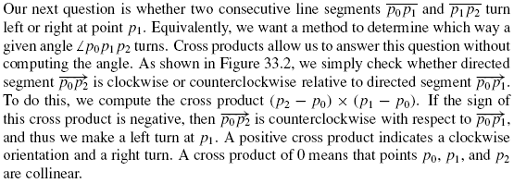
Finding left turn

Slide 13
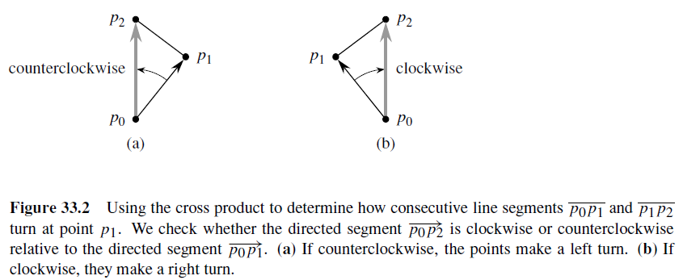
Finding left turn

Slide 14
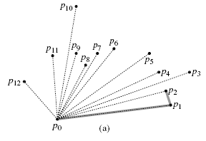
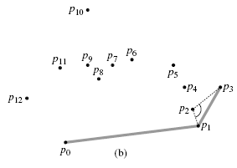
Convex hull: Example
The sequence p1, p2, . . . , p12 of points numbered in order of increasing polar angle relative to p0, and the initial stack S containing p0, p1, and p2.
Stack S after each iteration of the for loop of lines 6–9. Dashed lines show non-left turns, which cause points to be popped from the stack.

Slide 15
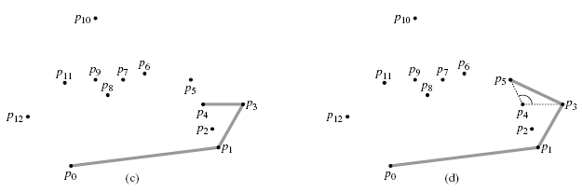
Convex hull: Example

Slide 16
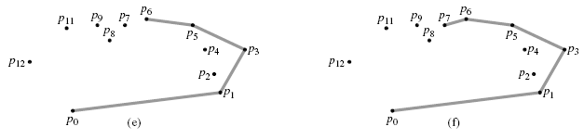
Convex hull: Example

Slide 17
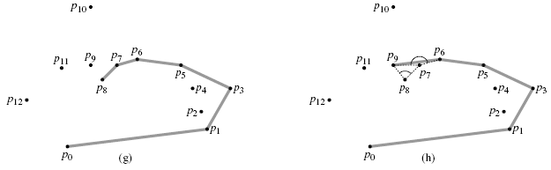
Convex hull: Example
the right turn at angle ےp7 p8 p9 causes p8 to be popped, and then the right turn at angle ے p6 p7 p9 causes p7 to be popped.

Slide 18
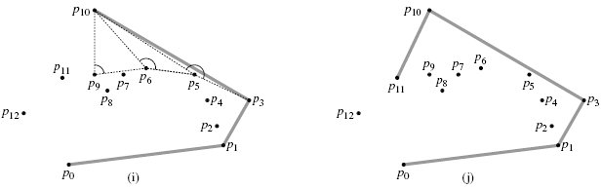
Convex hull: Example

Slide 19
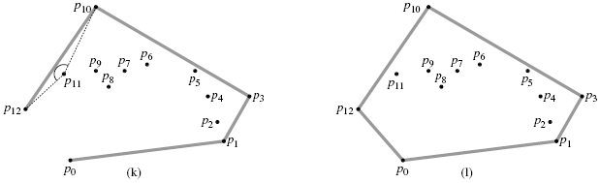
Convex hull: Example

